Slide 1
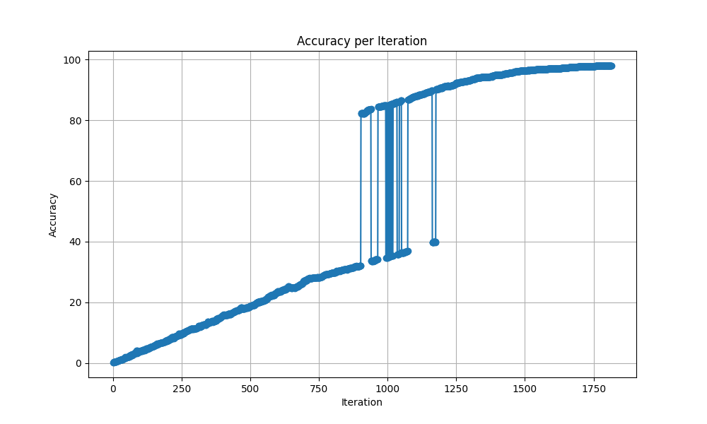
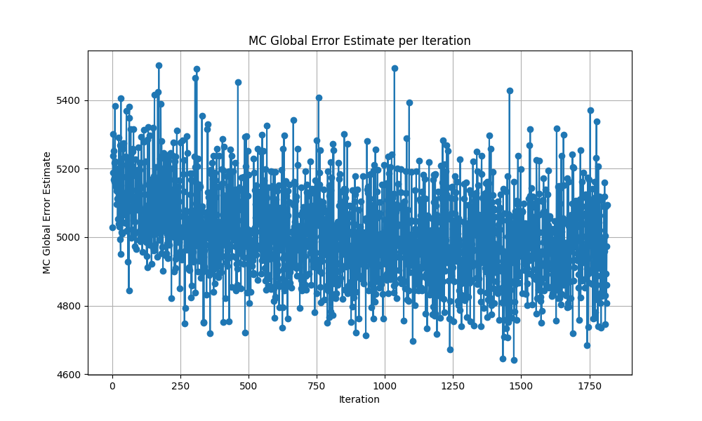
Multidimensional LHS sampling
grid changes,
mcglobalerror changes,
very noisy estimate

Slide 2
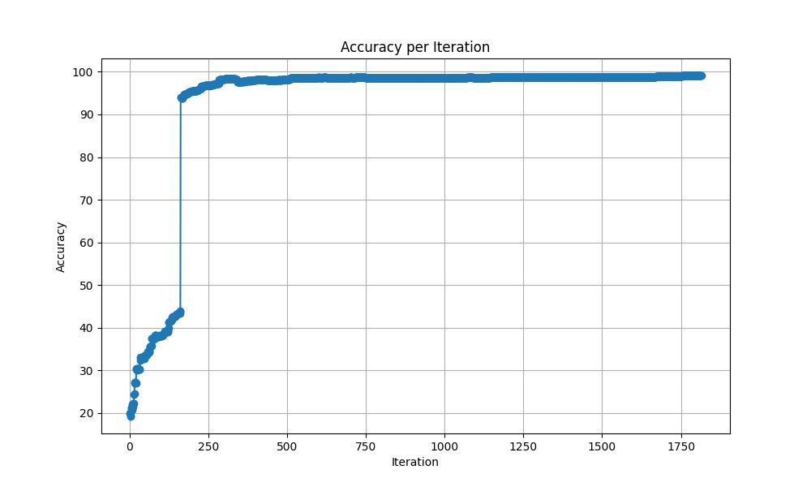
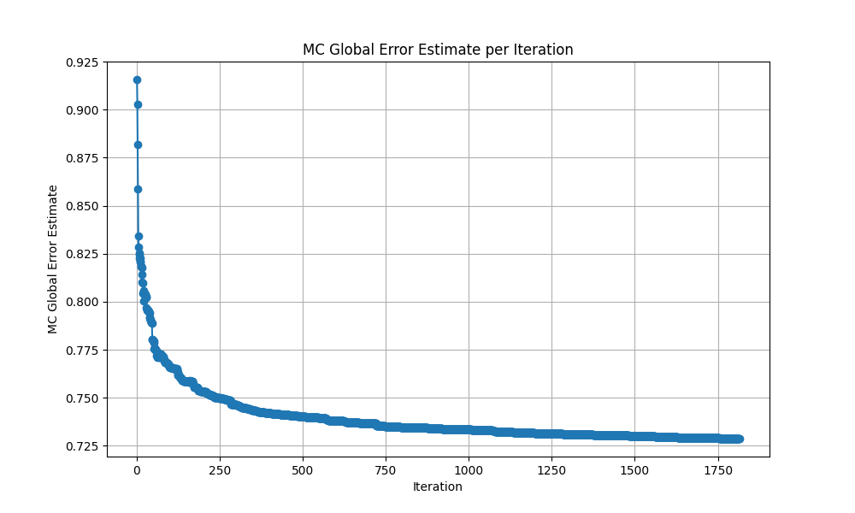
Fixed eval LHS sampling
- test grid fixed, candidate grid changes, much better, but error in starting samples

Slide 3
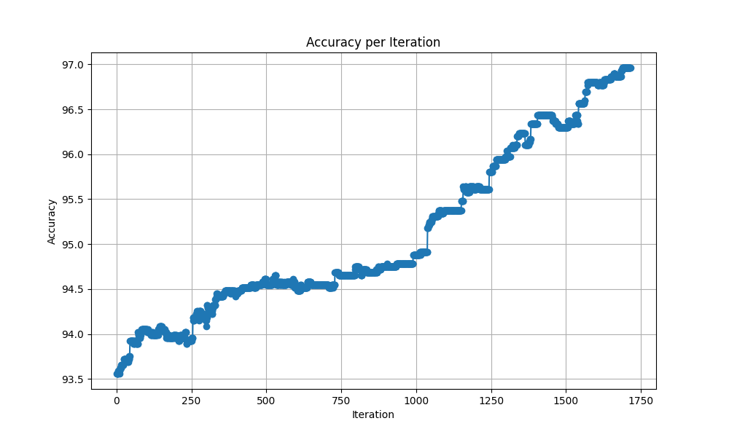
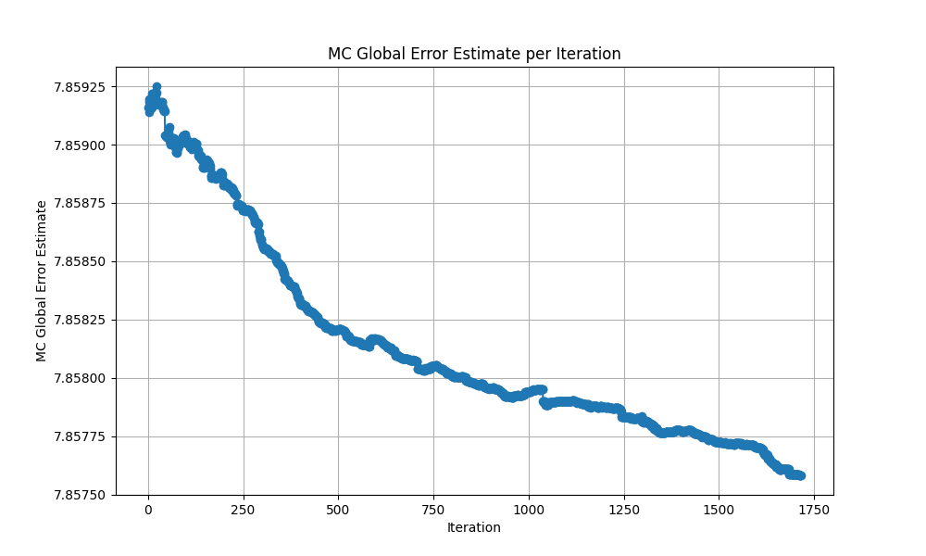
3d LHS corrected
- fixed test grid, starting estimate much higher now, not really going down near values of 0.1.
- model improvements on training data not improving regions sampled by lhs

Slide 4
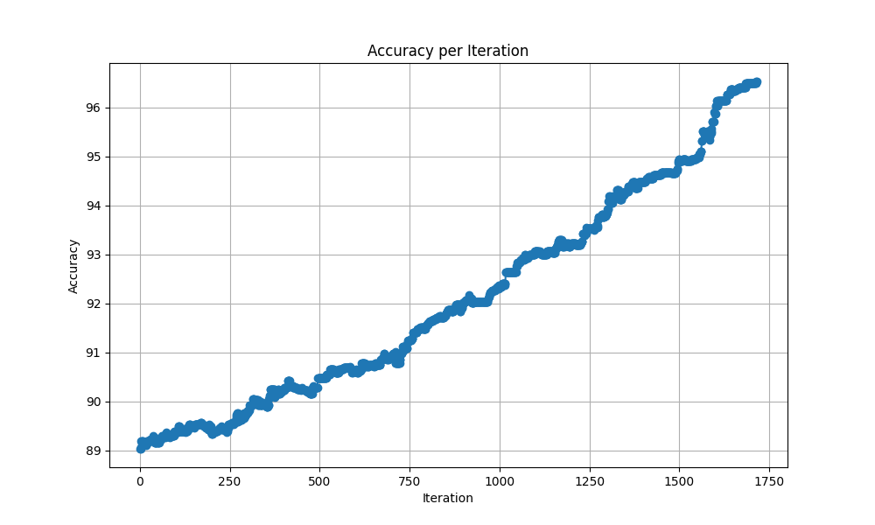
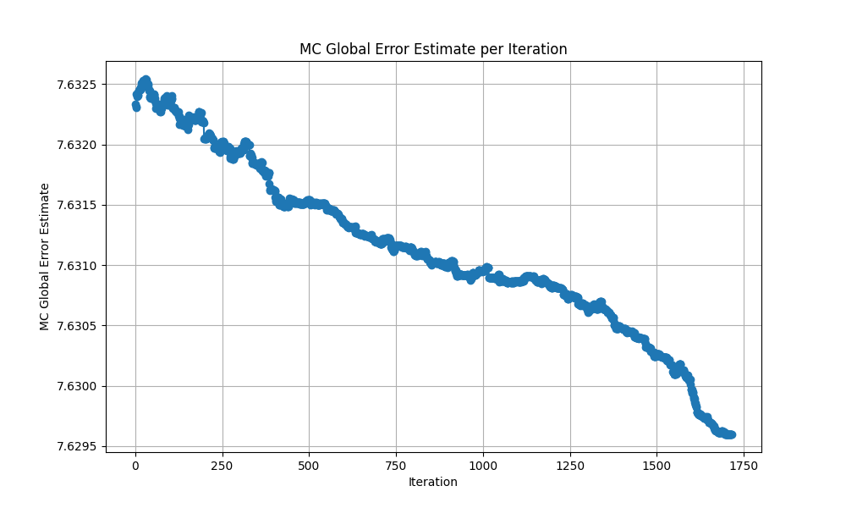
Sobol sampling
- Similar as before

Slide 5
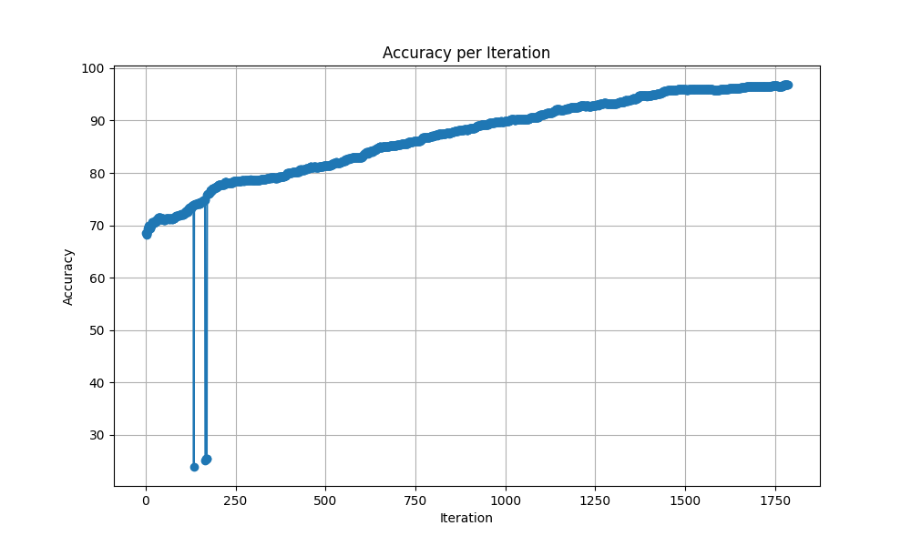
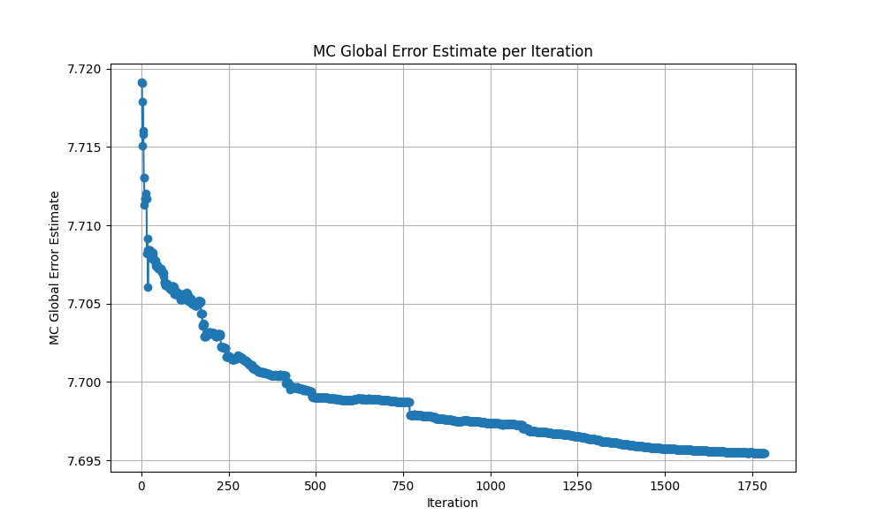
3d sobol sampling, 30 sample start

Slide 6
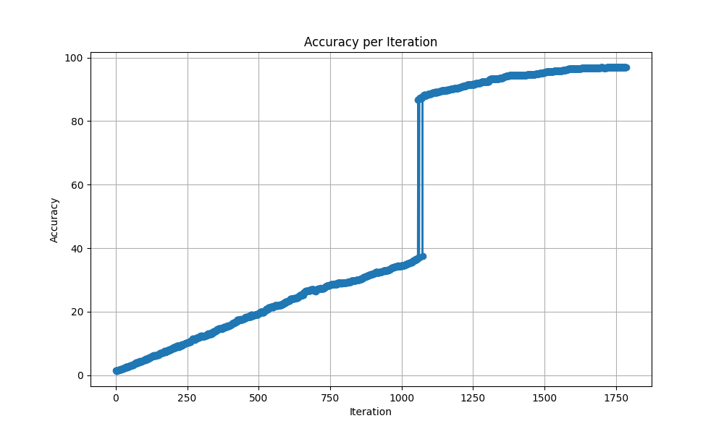
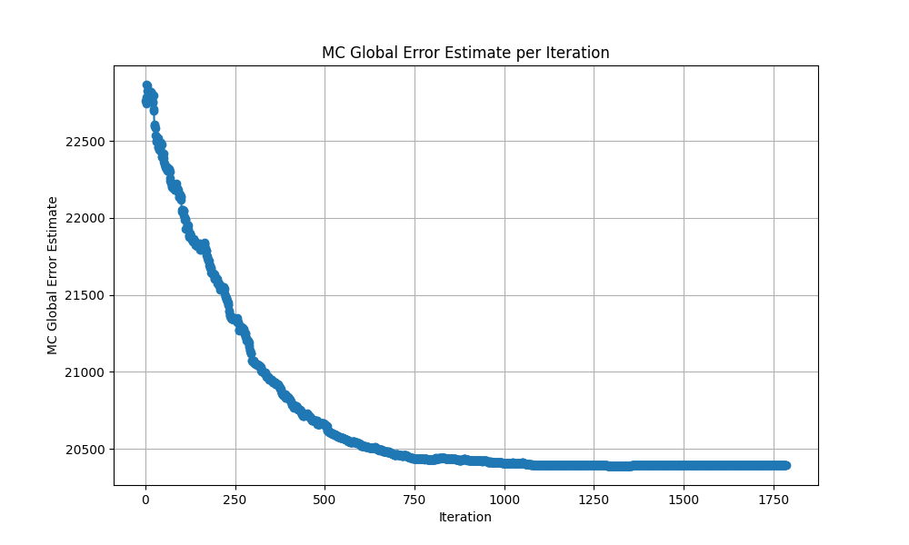
Fixed grid, multidimensional LHS, corrected
- scale is much larger for mc estimate, unclear what threshold values to pick for each property and combination of features

Slide 7
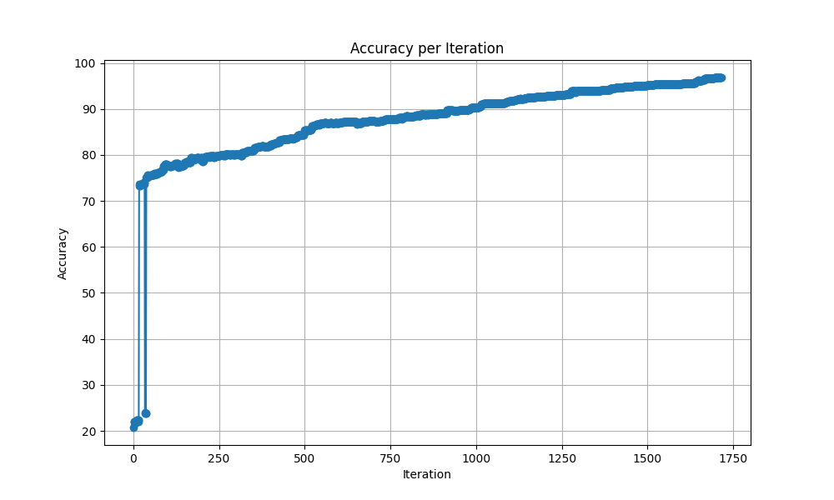
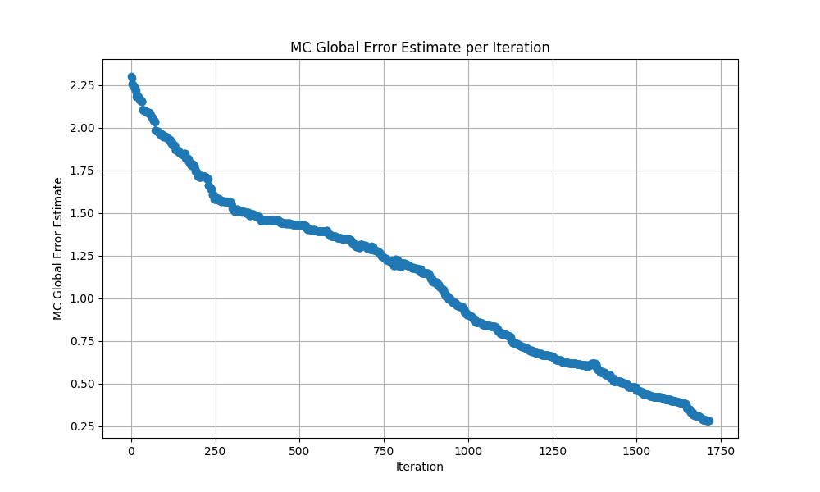
LHS CV split
- Doesnt really make sense to test on a grid when we have training data => use data for mc eval
- Mc error estimates fall close to 0.1, but different for each property

Slide 8
Thoughts
Doesn’t make sense to sample parameter space, acquisition function on the grid and then choose points closest
large nmc values not feasible
Find a way to sample directly from data effectively

Slide 9
Comparing plots between accuracy and mc error estimate can lead to finding optimal values for each property.
Might be sufficient to use r2 score, 95-99% threshold with training data
Accuracies low (for thermal conductivity and young modulus) because of kernel choice in adaptive training
Hyperparameter search ongoing for standard training, can answer what to use in adaptive as well

Slide 10
For upcoming week
sample directly from training data, somehow uniformly, non trivial
try to implement kernels for adaptive sampling, non trivial, requires derivatives of matern kernel (⌈ν⌉−1 differentiable), and possibly others
for standard, find optimal combinations of hyperparameters and kernels for each property with grid

